Slide 1
Financial Portfolio Tracking System <Release 2>
Jeff Kotowicz, Brett Kosciolek, Aaron Sloan, Daniel Dang, Sadaf Chowdhury & Zach Stauffer
Notes:
Jeff introduce; we say our names in order of on slide

Slide 2
Outline
New Class Structure
Updates to design
Something something slide stuff
Strengths & Weaknesses
Demo
Questions
Notes:
Brett

Slide 3
R2 Objectives
Refactor code (readability)
Better Implement Design Patterns
Overall, make design better
Refine simulations
Notes:
Zach

Slide 4
Class Structure
Model View Control structure
Split up god class for GUI
Broke apart portfolio class
Separate concerns
Notes:
Dan

Slide 5
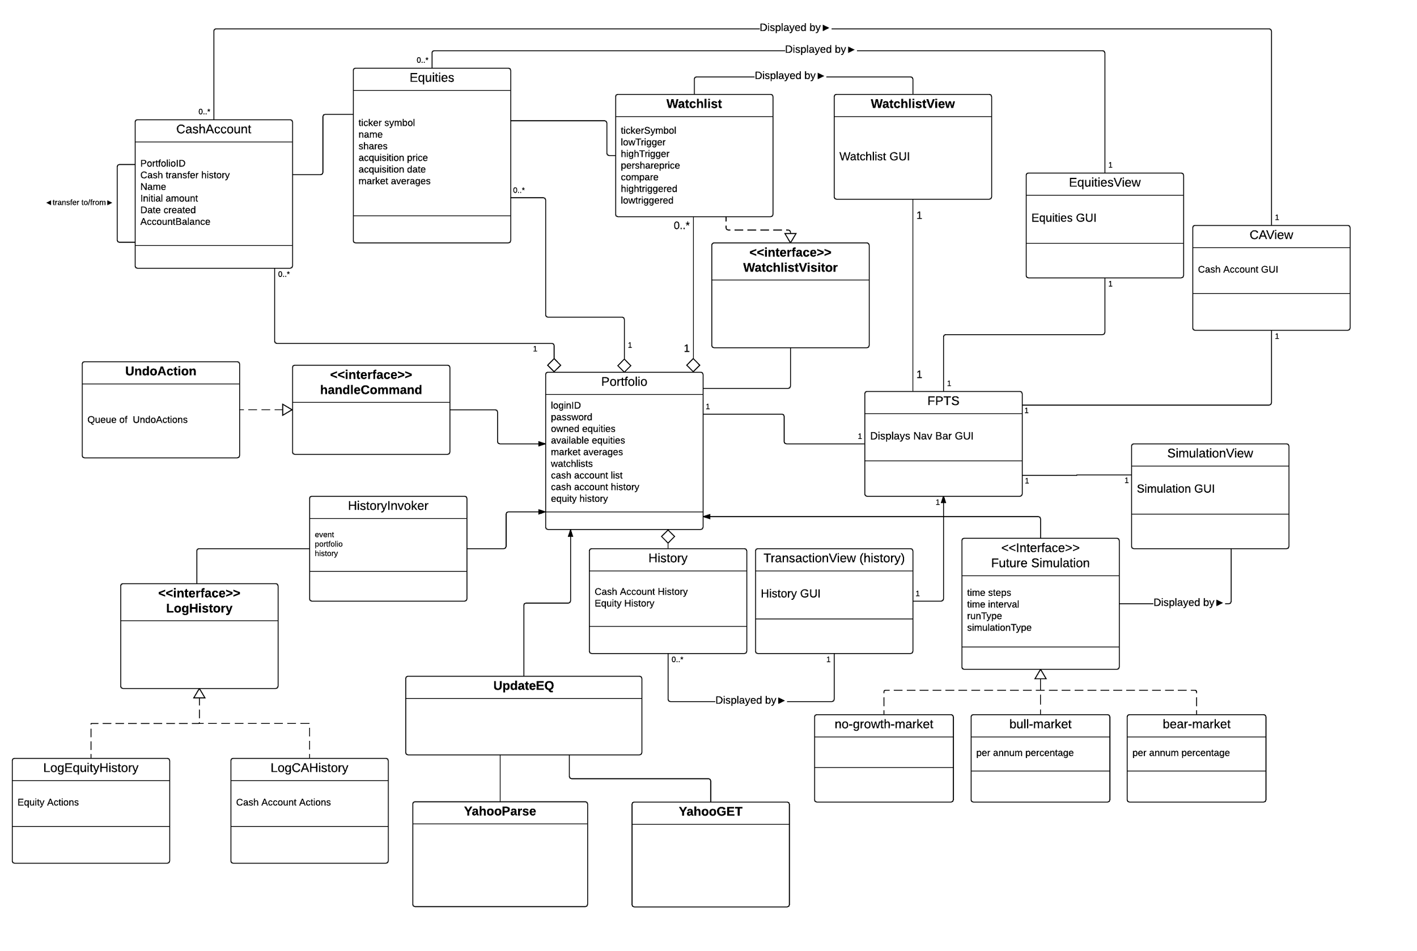
Notes:
Dan

Slide 6
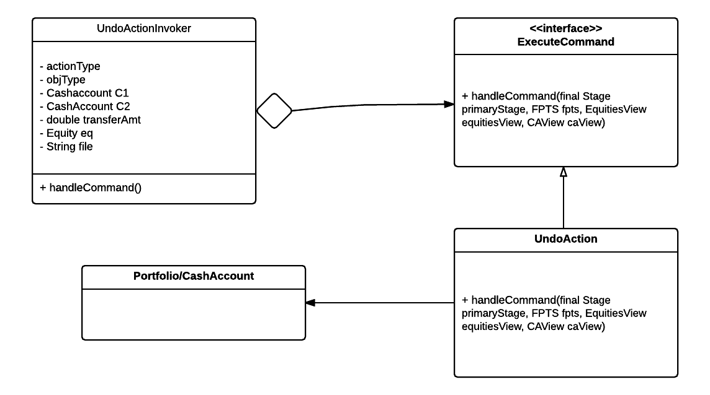
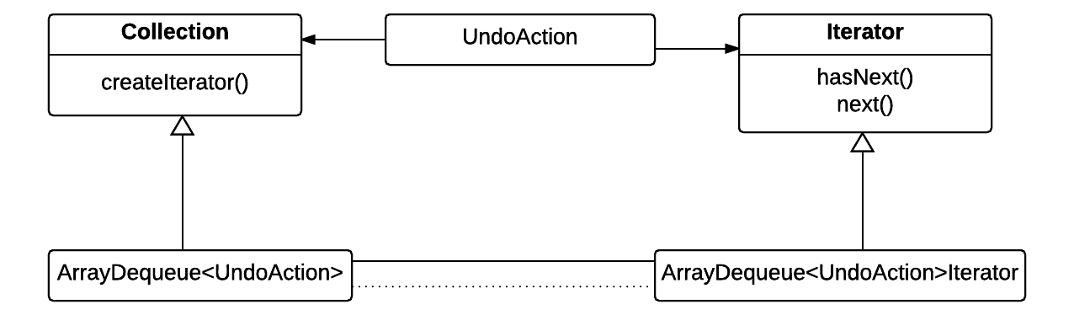
Updated Design
Old command pattern scrapped in use with history
Command & Iterator pattern implemented for Undo Actions
Notes:
Sadaf

Slide 7
Release 2 Positives and Setbacks
Positives
Able to set up more meetings
Better organization
Better understanding of requirements between releases
Setbacks
Delayed feedback limited refactoring time
Refactoring for R2 took time
Implementation taking longer than expected
Notes:
Aaron

Slide 8
Strengths & Weaknesses
Strengths
High cohesion
Low coupling due to MVC
Weaknesses
Design patterns are a bit weak
Too many pop-up windows
Notes:
Brett

Slide 9
Demo!
Notes:
Jeff

Slide 10
Any Questions???

